Slide 1


Zonal Load Factor Analysis
Electric Power Load Analysis (EPLA)
Revision of 27 May 2026
Dr. Norbert Doerry
http://doerry.org/norbert/MarineElectricalPowerSystems/index.htm
© 2026 by Norbert Doerry
This work is licensed via: CC BY 4.0 (https://creativecommons.org/)

Slide 2
Essential Questions
What is the purpose of zonal load factor analysis? | Remember
How is the zonal load factor calculated? | Apply
How is the zonal load factor applied? | Apply

Slide 3
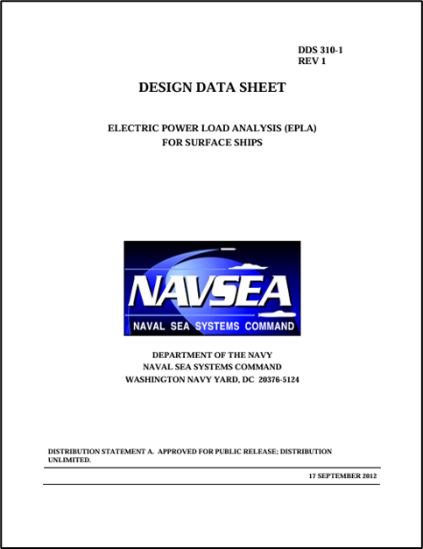
Zonal Load Factor Analysis
With cycling or intermittent loads, load factor analysis (based on 24-average load) underestimates the required rating of power system equipment.
Zonal load factors are modifications of the load factor for 24-hour average computations to account for additional capacity needed due to cycling loads
  Does not impact load factors for constant power loads
  Is not perfect
    Can still under-estimate the required rating
    Much closer than load factor analysis
Process defined in DPC 310-1

Slide 4
Zoal Load Factor analysis
For each load determine …
  Connected Load (kW)
  Peak Load (kW)
  Average Load (kW)
24-hour average load factor is average load divided by the connected load
Calculate the zonal load factor for each load
Calculate the zonal operating load for each load
  Zonal load factor times the connected load
Calculate the residual zonal power demand for each load
  Peak load minus the zonal operating load
Calculate the zonal total operating load
  Sum of all the zonal operating loads plus the maximum residual zonal power demand
Calculate zonal demand power
  Apply margin and service life allowance (SLA)

Slide 5
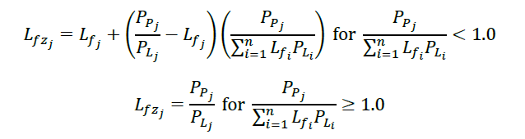
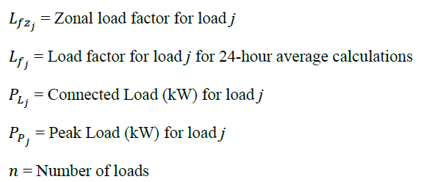
Calculating Zonal Load Factor
Based on relative magnitudes of other loads powered by the electrical system equipment

Slide 6


Example 1
9 constant power loads (10 kW each) and one cycling load
  Peak value 50 kW
  On time between 3 and 4 time units
  Off time between 27 and 36 time units
Average value of total load is 95 kW
Peak value of total load is 140 kW
Load factor for 24 hour calculations
  Constant power loads = 1.0
  Cycling Load = 0.10
Zonal load factor
  Constant power loads
  Cycling load
Zonal operating load
  Constant power loads = 10 kW
  Cycling load = 0.574 × 50 = 28.7 kW
Residual zonal power demand
  Constant power load = 0 kW
  Cycling load = 50 – 28.7 = 21.3 kW
Zonal total operating load
  9 × 10 + 28.7 + 21.3 = 140 kW.
Using Average Value of 95 kW will likely lead to undersized power system equipment.
Using Zonal total operating load of 140 kW helps ensure equipment will not be overloaded.
Must still apply margin and SLA.

Slide 7

Example 2
8 constant power loads (10 kW each) and 2 cycling load
  Peak value 50 kW
  On time between 3 and 4 time units
  Off time between 27 and 36 time units
Average value of total load is 90 kW
Peak value of total load is 180 kW
Load factor for 24 hour calculations
  Constant power loads = 1.0
  Cycling Load = 0.10
Zonal load factor
  Constant power loads = 1.0
  Cycling load
Zonal operating load
  Constant power loads = 10 kW
  Cycling load = 0.6 × 50 = 30 kW
Residual zonal power demand
  Constant power load = 0 kW
  Cycling load = 50 – 30 = 20 kW
Zonal total operating load
  8 × 10 + 2 × 30 + 20 = 160 kW.
Using Average Value of 90 kW will likely lead to undersized power system equipment.
Using Zonal total operating load of 160 kW helps ensure equipment will not be overloaded…
  A little lower than 180 kW peak but likely manageable
Must still apply margin and SLA.

Slide 8

Example 3
7 constant power loads (10 kW each) and 3 cycling load
  Peak value 50 kW
  On time between 3 and 4 time units
  Off time between 27 and 36 time units
Average value of total load is 85 kW
Peak value of total load
  Theoretical = 220 kW
  Observed = 170 kW (All three cycling loads on at same time is unlikely)
Load factor for 24 hour calculations
  Constant power loads = 1.0
  Cycling Load = 0.10
Zonal load factor
  Constant power loads = 1.0
  Cycling load
Zonal operating load
  Constant power loads = 10 kW
  Cycling load = 0.629 × 50 = 31.4 kW
Residual zonal power demand
  Constant power load = 0 kW
  Cycling load = 50 – 31.4 = 18.6 kW
Zonal total operating load
  7 × 10 + 3 × 31.4 + 18.6 = 183 kW.
Using Average Value of 85 kW will likely lead to undersized power system equipment.
Using Zonal total operating load of 183 kW helps ensure equipment will not be overloaded…
  A little lower than 220 kW theoretical peak
  More than observed peak 170 kW
Must still apply margin and SLA.

Slide 9
Final note
Power equipment typically are able to sustain overloads for short periods of time
  Transformers and synchronous generators are very robust and generally can tolerate short term overloads that are not likely, but possible.
  Power electronic sources usually are not as robust.
    May require more detailed analysis to determine if cycling loads will result in Quality of Service defined service interruptions.
Zonal load factors are greater than or equal to 24-hour average load factors
  Will provide the same or a more conservative estimate for the required power.
  The worst possible case electric load may be greater than that predicted by zonal load factors.

